Slide 1
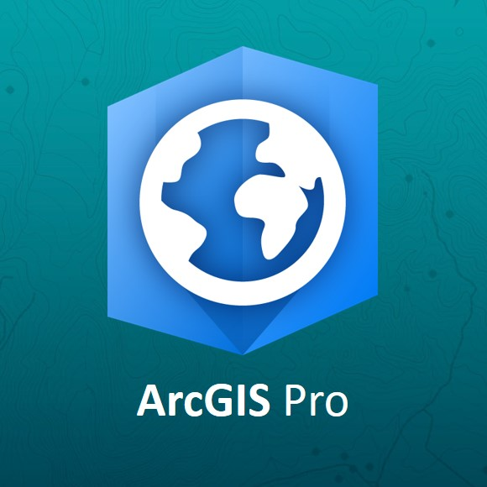
GEOG 390 PRINCIPLES OF GIS
LAB 1
Introduction to ArcGIS Pro
Image collected from ESRI UK-Ireland community hub

Slide 2

Quiz Time
Log in to eCampus
Course materials>Labs>Lab 1 materials
Total 5 pts. (1pt. each)
Once started, the quiz will be submitted automatically in 5 mins.

Slide 3

Today’s Class
Access to GEOS account
Basic (necessary!) computing tips
Terminologies
Basic ArcGIS Pro Tips
What to submit
How to submit

Slide 4

Office Hour Update
Email: rahasan@tamu.edu
(Use your TAMU email address only)
Office hours:
311 CSA, Tuesday 11am-1pm or by appointment.
Use Google Form (link in the syllabus (https://forms.gle/iRjajor8eEfgjngD9)

Slide 5

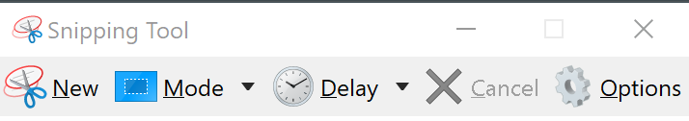
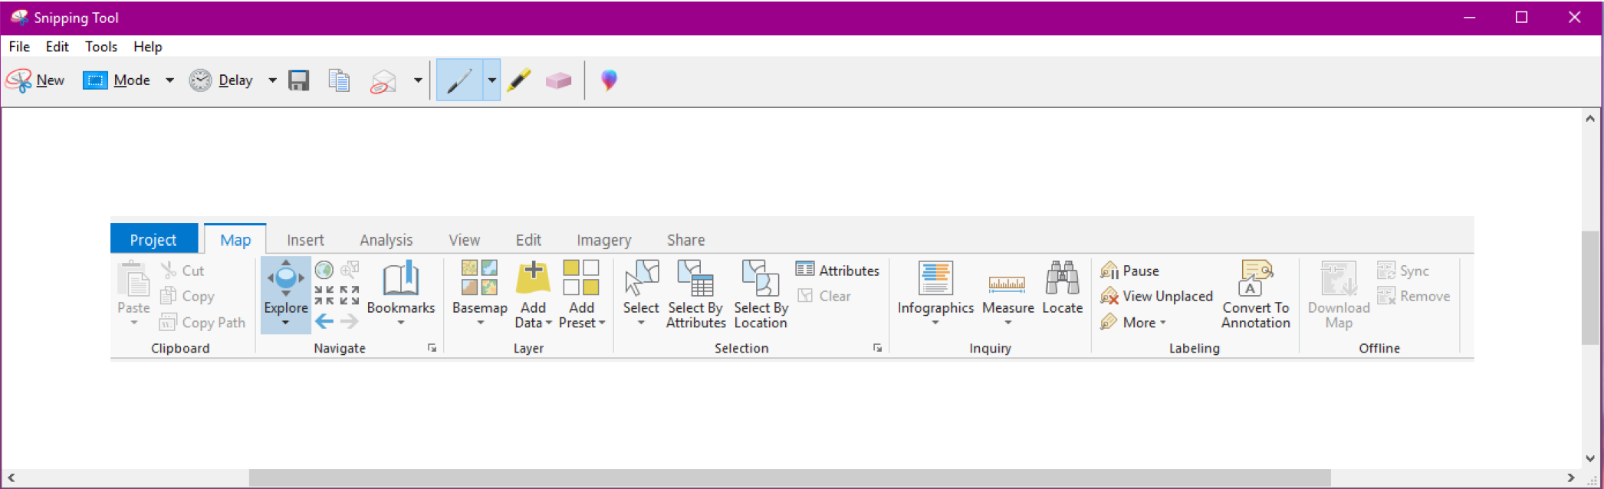
Capturing Screenshots
press the PrtScn button on your keyboard
open the Paint program, then choose Paste (click the clipboard) and your screen capture will appear.
The Snipping tool allows more flexibility

Slide 6




Saving as PDF
Open Microsoft Word (Word)
Click on “File”, go to “Save as”
Select the location where you want to save
Type the name you want your file to be named
Select “Pdf” as file type from the drop down

Slide 7

So what are we going to do today?

Slide 8

Data and instructions
Course materials>labs
Download mastering ArcGIS pro tutorial data
Download lab 1 materials
Rubric is provided on the lab materials folder
Download both files
Read the instructions carefully
Use the response template to submit your answers!
Some of the questions for the lab are different than the lab manual – answer what the template asks, not what the manual asks

Slide 9

Data Extract
Right-click the “mastering arcgis pro tutorial data” (zipped folder)
Hover over 7-zip
Select “extract all”
Specify the target folder to save your data
Not the c: drive
Flash drive, student drive, etc.

Slide 10

ArcGIS & ArcGIS Pro
Interface
Ribbon(s)
Symbology
Measurement tool

Slide 11
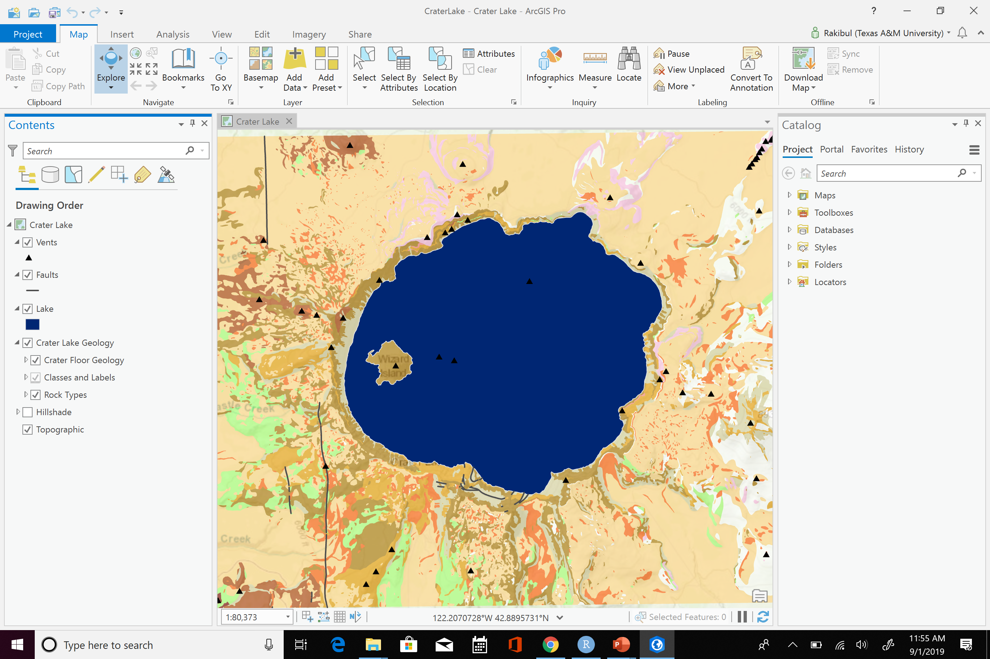
Ribbon tiles
Ribbon groups
View tab
Catalog Pane
(Access to your
projects and folder)
Contents Pane
(list your layers)

Slide 12

Terms to Know
Folder
Project
aprx
Map
Geodatabase
Shapefile
Content Pane
Catalog Pane
Feature Class

Slide 13

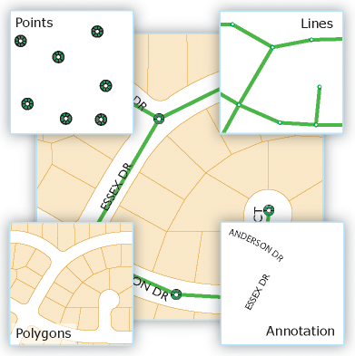
Feature Class
Points
Lines
features that are too small to represent as lines or polygons as well as point locations (such as GPS observations).
represent the shape and location of geographic objects, such as street centerlines also used to represent features that have length but no area, such as contour lines and boundaries.
Polygons
a set of many-sided area features that represents the shape and location of homogeneous feature types such as states, counties, parcels, soil types, and land-use zones.
http://desktop.arcgis.com/en/arcmap/10.3/manage-data/geodatabases/feature-class-basics.htm

Slide 14
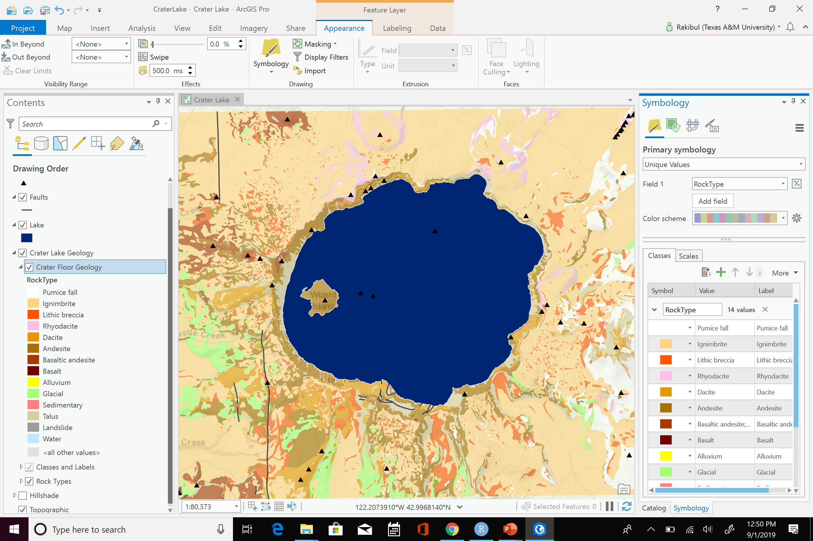

Symbology
Adjusting symbology
Click on symbology under the feature layer (Lakes)
Symbology pane will open on the right side and select a new one

Slide 15
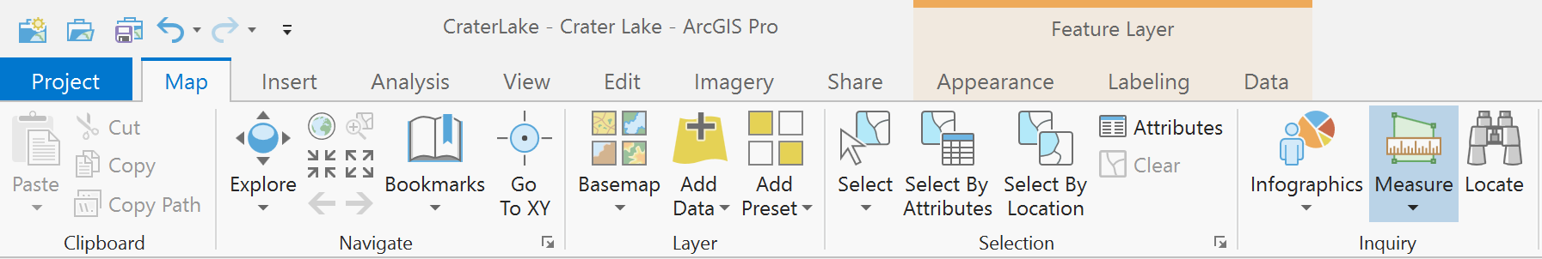

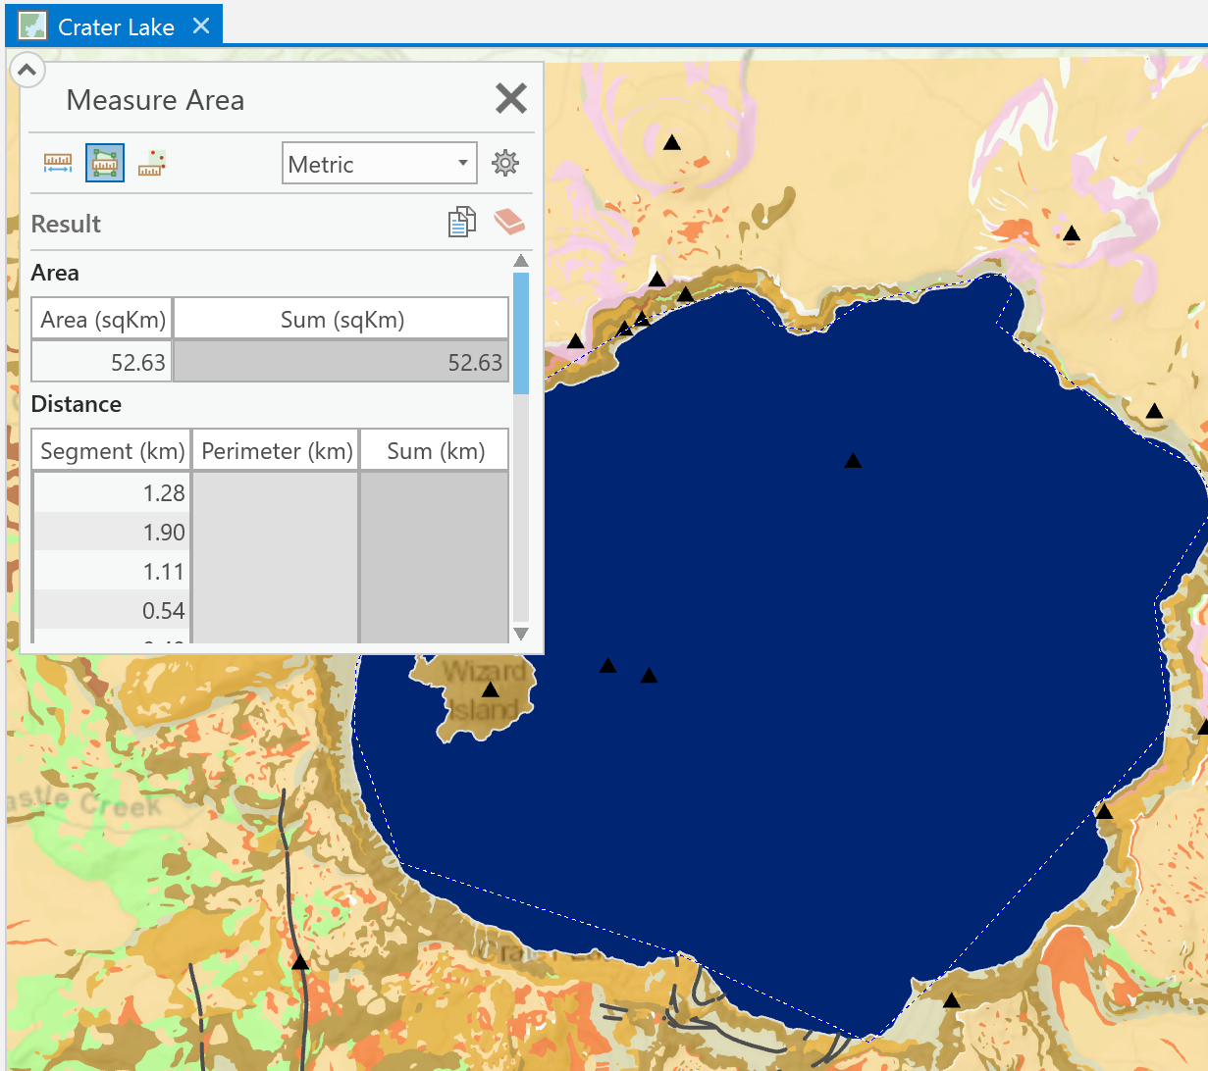
Measure Tool

Slide 16

What to Turn in
Run through the tutorial, only answer the questions in the response template
Follow the response template (tells you what to skip)
If you accidentally close catalog or contents panes, go to view → reset panes to default
Due next week
Section 501: September 9 at 9:10 am
Section 503: September 9 at 4:10 pm

